Slide 1
Network Forwarding and Link Access
Qiao Xiang
https://qiaoxiang.me/courses/cnns-xmuf21/index.shtml
12/14/2021
This deck of slides are heavily based on CPSC 433/533 at Yale University, by courtesy of Dr. Y. Richard Yang.

Slide 2
Outline
Admin and recap
Network layer
Overview
Routing
Link weights assignment
Routing computation
Basic routing computation protocols
Global Internet routing
Basic architecture
BGP (Border Gateway Protocol): The de facto Inter-domain routing standard
Basic operations
BGP as a policy routing framework (control interdomain routes)
Policy/interdomain routing analysis
Global preference aggregation and Arrow’s Theorem
Local preference aggregation
Economics and interdomain routing patterns
IP addresses for interdomain routing
Forwarding
Link layer

Slide 3
Recap: Policy Routing Analysis
210
20
Local preference introduces dependency
Complete dependency can be captured by a structure called P-graph
If the P-graph of the networks has no loop, then policy routing converges.
2
0
130
10
1
3
320
30
1 3 0
2 1 0
3 2 0
1 0
2 0
3 0
3

Slide 4
Recap: Interdomain Routing and Economics
Economics => typical routing selection policy and export policies
Typical export policies => routes have patterns
e.g., Valley free routing
Assumptions on economical relationship => a proof of no loop in P-graph.
4

Slide 5
Recap: Interdomain Routing and IP Addressing
Requirements
Uniqueness
Allow aggregation
=>
Classless InterDomain Routing (CIDR) addressing adopted in Internet

Slide 6
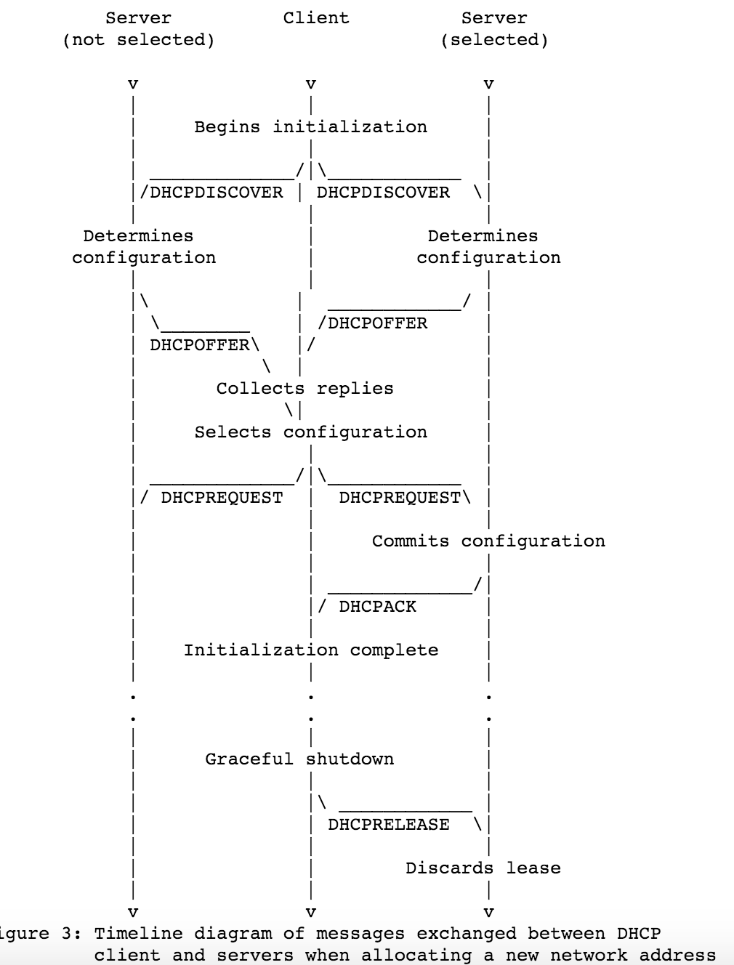
Recap: DHCP: Dynamic Host Configuration Protocol
The often used DORA model (4 messages)
host broadcasts “DHCP discover” msg
DHCP server responds with “DHCP offer” msg
host requests IP address: “DHCP request” msg
DHCP server sends address: “DHCP ack” msg

Slide 7
Outline
Admin and recap
Network layer
Overview
Routing
Forwarding (put it together)

Slide 8
Network Forwarding: Putting it Together
Forwarding is also called the fast path (upon receiving each packet)
Slow path: not per packet
Get IP address (DHCP, or static)
Setup/compute routing table

Slide 9
Forwarding: Example 1
src
dst
misc
fields
223.1.1.1
223.1.1.3
data
Setting: Host A network layer receives a packet above.
Action:
Host A looks up destination in routing table
Exercise: Suppose A uses DHCP to obtain its address, how can A construct its routing table (routing information base, RIB)?
A
To Internet
223.1.1.1
223.1.4.1
223.1.2.1
223.1.1.2
223.1.1.4
223.1.2.9
223.1.2.2
223.1.1.3
223.1.3.27
223.1.3.1
223.1.3.2

Slide 10
Host Routing Table Example: Zoo
Zoo
ifconfig –a
netstat –rn (man netstat to see description)
[yry3@cicada ~]$ netstat -rn
Kernel IP routing table
Destination Gateway Genmask Flags MSS Window irtt Iface
0.0.0.0 128.36.232.1 0.0.0.0 UG 0 0 0 enp0s25
128.36.232.0 0.0.0.0 255.255.255.0 U 0 0 0 enp0s25
130.132.1.57 128.36.232.1 255.255.255.255 UGH 0 0 0 enp0s25
192.168.122.0 0.0.0.0 255.255.255.0 U 0 0 0 virbr0

Slide 11
Host Routing Table Example: my Mac
Mac
ifconfig –a
netstat –rn (man netstat to see description)
Routing tables
Internet:
Destination Gateway Flags Refs Use Netif Expire
default 172.27.16.1 UGSc 1470 0 en0
127 127.0.0.1 UCS 1 0 lo0
127.0.0.1 127.0.0.1 UH 4 3788 lo0
169.254 link#4 UCS 106 0 en0
169.254.1.229 link#4 UHLSW 1 0 en0
169.254.5.209 f0:99:bf:1e:6f:de UHLSW 1 0 en0 989
169.254.8.254 link#4 UHLSW 1 0 en0
169.254.11.96 0:cd:fe:75:59:75 UHLSW 1 0 en0 1009
169.254.13.89 64:9a:be:af:34:53 UHLSW 1 0 en0 1145
169.254.16.49 link#4 UHLSW 1 0 en0
169.254.19.58 link#4 UHLSW 1 0 en0
169.254.19.82 link#4 UHLSW 1 0 en0
169.254.21.198 link#4 UHLSW 1 0 en0
169.254.22.67 0:23:12:12:bc:39 UHLSW 1 0 en0 31
169.254.23.4 link#4 UHLSW 1 0 en0
...

Slide 12
CIDR Forwarding Look Up: Software
default: -
# prefix interface
a) 00001
0
1
b) 00010
a
c) 00011
d) 001
g
e) 0101
f) 011
f
d
h
g) 10
h) 100
i) 1010
i
e
j
k
j) 1011
k) 1100
The RIB are represented by a decision tree, e.g., a Patricia Trie to look for the longest match of the destination address
a
b
c

Slide 13
Putting it Together: Example 1: A->B
src
dst
forwarding table in A
misc
fields
Dest. Net. next router Nhops
223.1.1.1
223.1.1.3
data
223.1.1/24 1
223.1.2/24 223.1.1.4 2
Setting: Host A network layer receives a packet above.
Action:
Host A looks up destination in routing table (on same subnet)
Hand datagram to link layer to send inside a link-layer frame
Key step: need to map B’s IP address 223.1.1.3 to B’s MAC address
223.1.3/24 223.1.1.4 2
0.0.0.0/0 223.1.1.4 -
A
To Internet
223.1.1.1
223.1.4.1
223.1.2.1
223.1.1.2
223.1.1.4
223.1.2.9
B
223.1.2.2
223.1.1.3
223.1.3.27
223.1.3.1
223.1.3.2

Slide 14
Comparison of IP address and MAC Address
IP address is locator
address depends on network to which an interface is attached
NOT portable
introduces features (e.g., CIDR) for routing scalability
IP address needs to be globally unique (if no NAT)
MAC address is an identifier
dedicated to a device
portable
flat
MAC address does not need to be globally unique, but the current assignment ensures uniqueness

Slide 15
Issue
A finds the MAC address of B to construct
A
223.1.1.1
223.1.2.1
223.1.1.2
223.1.1.4
223.1.2.9
B
223.1.1.3
223.1.3.27
223.1.2.2
223.1.3.1
223.1.3.2
frame source,
dest address
datagram source,
dest address
B’s MAC
addr
A’s MAC
addr
A’s IP
addr
B’s IP
addr
IP payload
datagram
frame

Slide 16
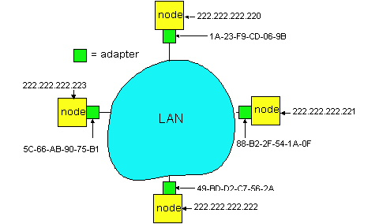
Recall: Address Resolution Table
Each IP node (Host, Router) on LAN has ARP table
ARP Table: IP/MAC address mappings for some LAN nodes
< IP address; MAC address; TTL>
TTL (Time To Live): time after which address mapping will be forgotten (typically 20 min)
[yry3@cicada yry3]$ /sbin/arp
Address HWtype HWaddress Flags Mask Iface
zoo-gatew.cs.yale.edu ether AA:00:04:00:20:D4 C eth0
artemis.zoo.cs.yale.edu ether 00:06:5B:3F:6E:21 C eth0
lab.zoo.cs.yale.edu ether 00:B0:D0:F3:C7:A5 C eth0

Slide 17
Recall: ARP Protocol
ARP table by the ARP Protocol, which is a “plug-and-play” protocol
nodes create their ARP tables without intervention from net administrator
A broadcast protocol:
source broadcasts query frame, containing queried IP address
all machines on LAN receive ARP query
destination D receives ARP frame, replies
frame sent to A’s MAC address (unicast)

Slide 18
Putting it Together: Example 2 (Different Networks): A-> E
forwarding table in A
misc
fields
223.1.1.1
223.1.2.3
data
Dest. Net. next router Nhops
Setting: Host A network layer receives a packet above.
Action:
Host A looks up destination in routing table
Find next hop should be 223.1.1.4
Hand datagram to link layer to send inside a link-layer frame
223.1.1/24 1
223.1.2/24 223.1.1.4 2
223.1.3/24 223.1.1.4 2
0.0.0.0/0 223.1.1.4 -
A
To Internet
223.1.1.1
223.1.4.1
223.1.2.1
223.1.1.2
223.1.1.4
223.1.2.9
frame dst, src addr
datagram source,
dest address
B
C
223.1.2.3
223.1.1.3
223.1.3.27
E
C’s MAC
addr
A’s MAC
addr
A’s IP
addr
E’s IP
addr
IP payload
223.1.3.1
223.1.3.2
datagram
frame

Slide 19
Exercise: Actions at a Router
Source: https://nmap.org/book/tcpip-ref.html

Slide 20
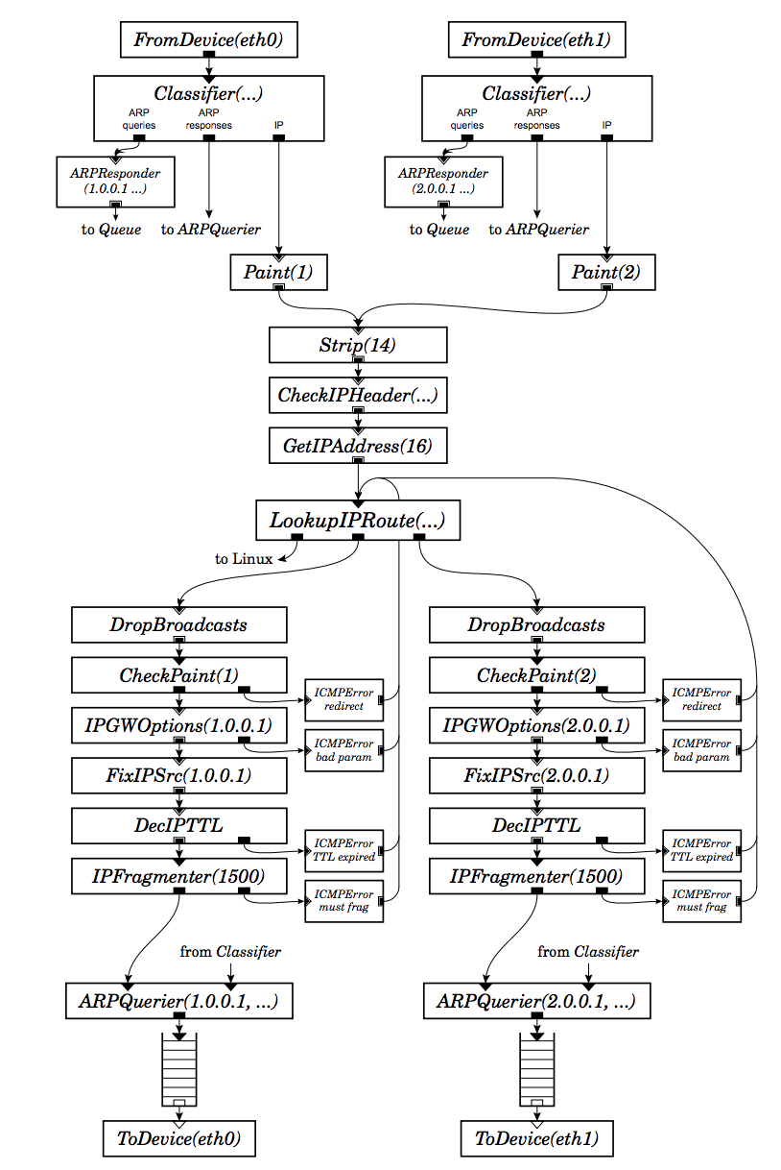
Router Actions
Routing
Look up
Prevent loops (TTL--)
Notify host better routers (ICMP redirect)
Handle IPGW options
(e.g., record routes)
Handle fragmentation
Error checking and reporting using ICMP
Scheduling (e.g., linux tc)
20

Slide 22
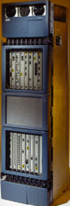
What A Router Looks Like: Outside

Slide 23
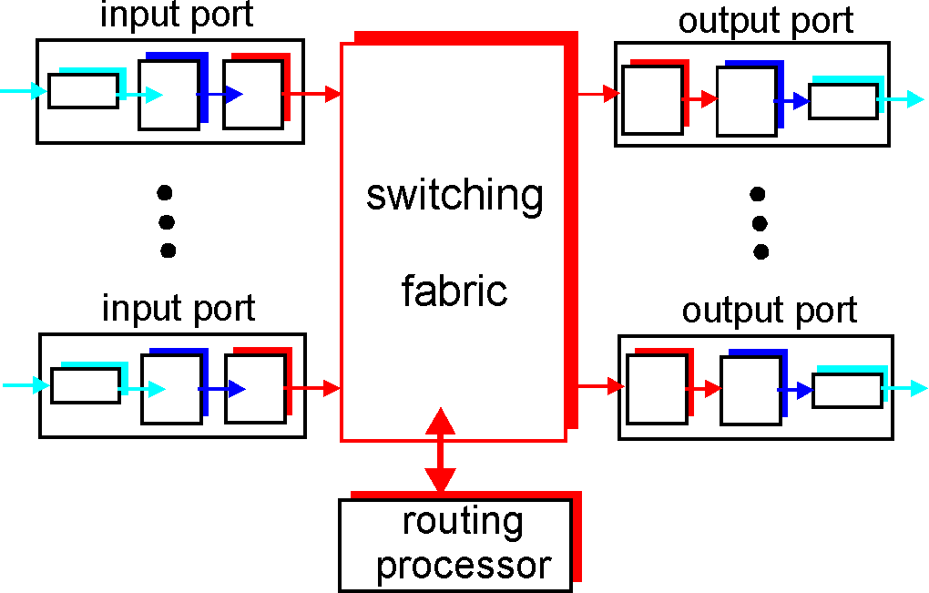
Look Inside a Router

Slide 24
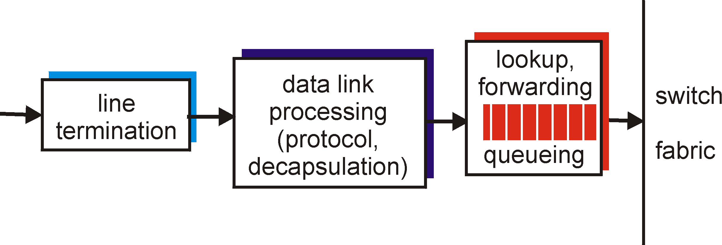
Look Inside a Router: Input Port
physical layer:
bit-level reception
data link layer:
e.g., Ethernet
network layer:
lookup output port using forwarding table

Slide 25
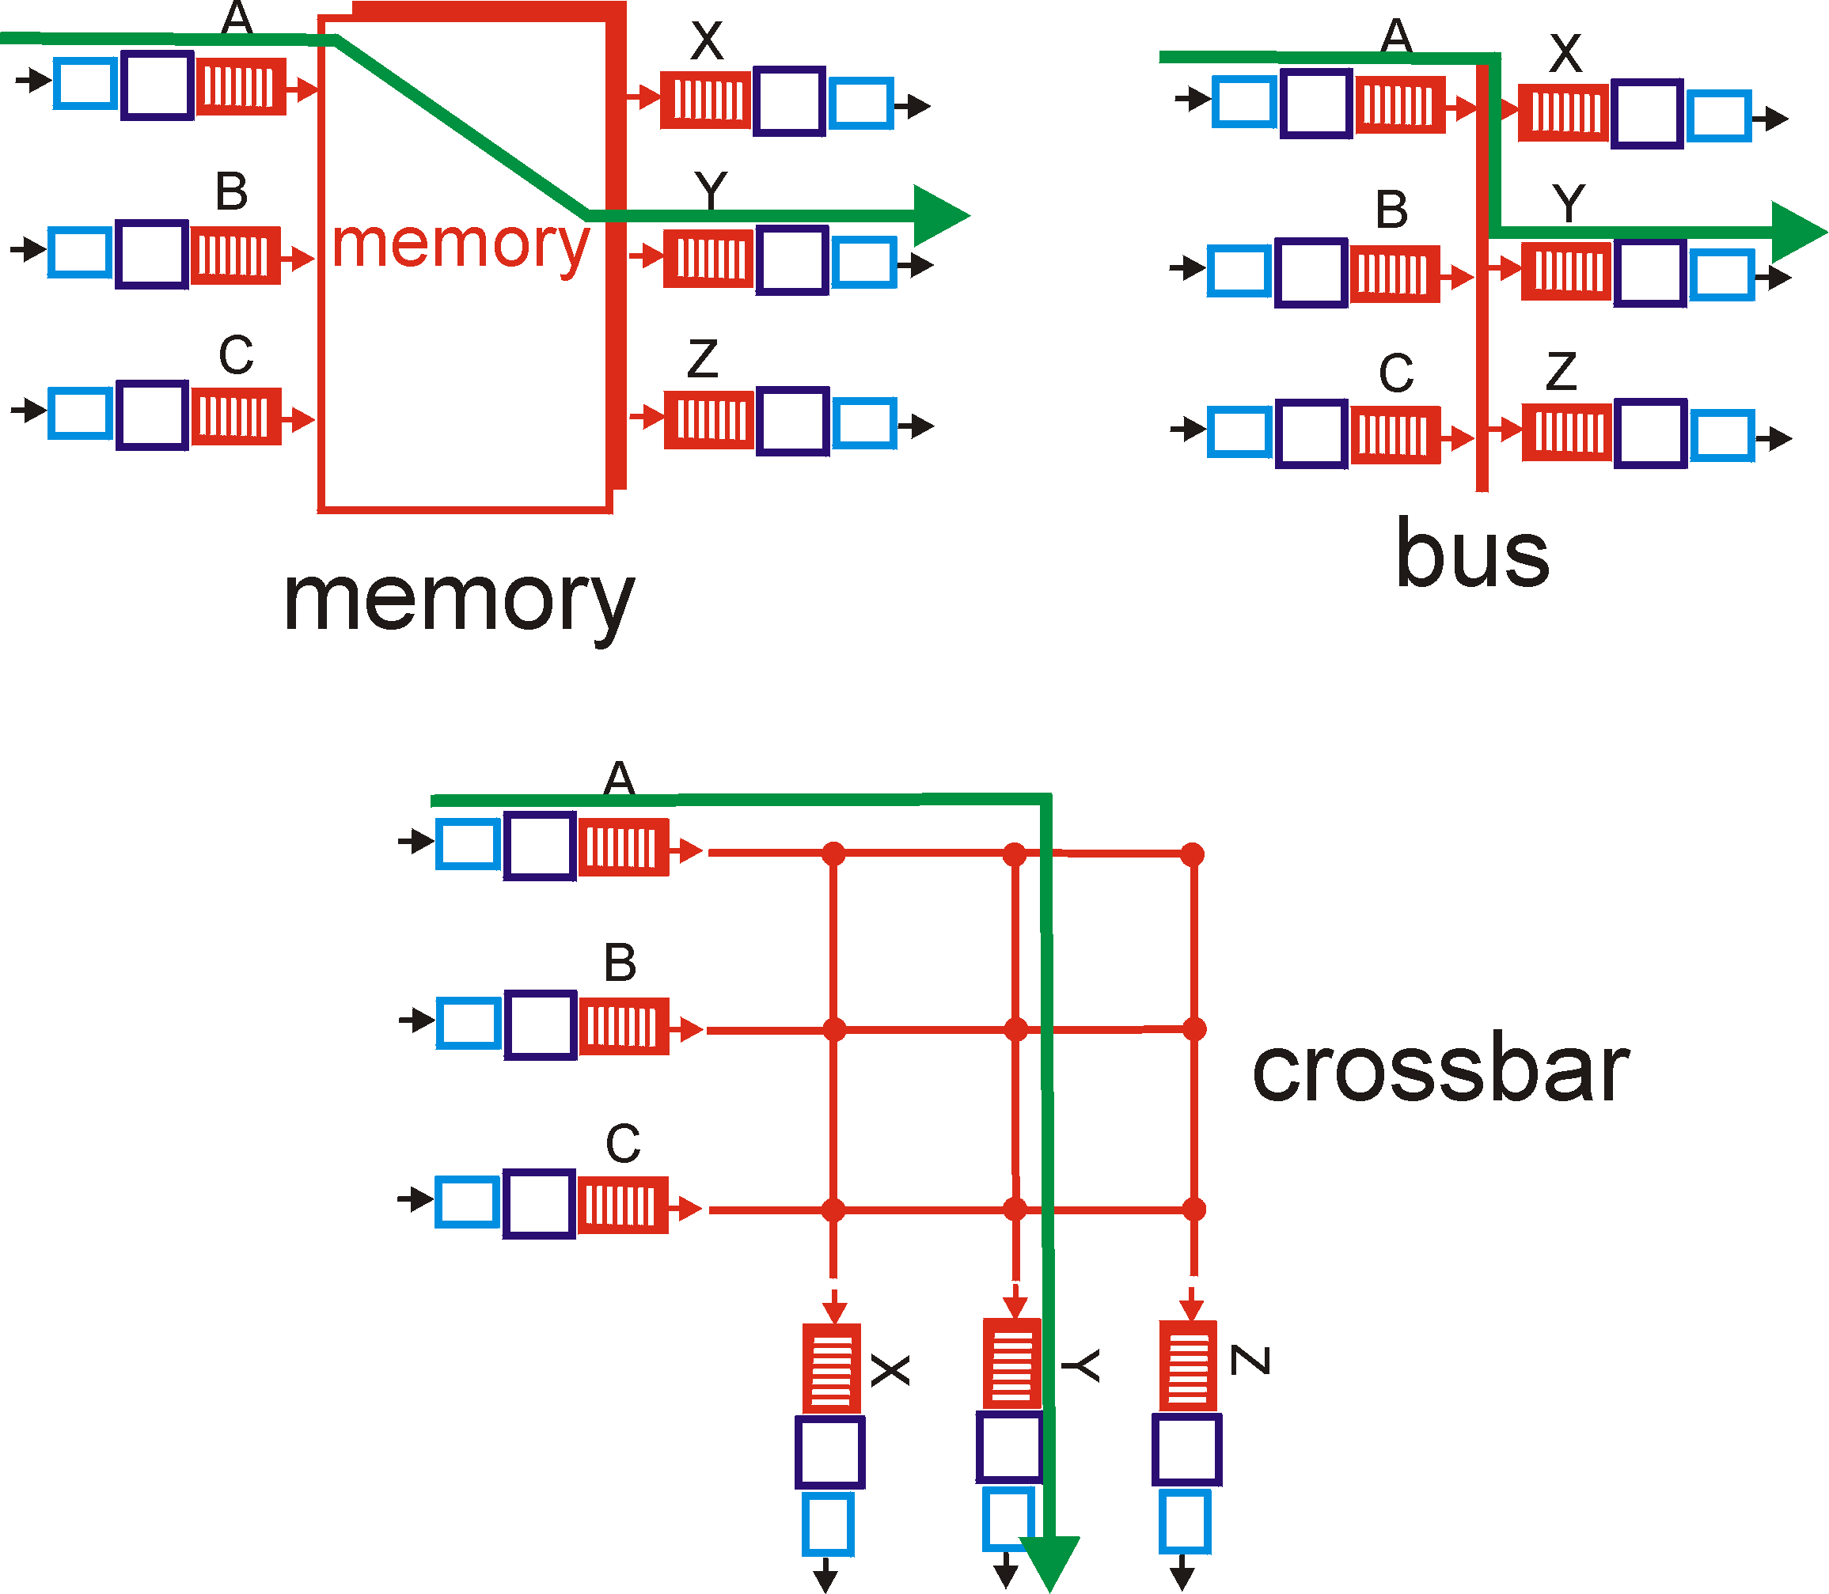
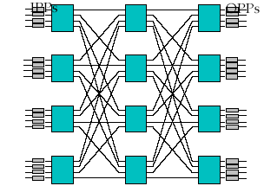
Look Inside a Router: Switching Fabric
Low
End
High
End
Banyan

Slide 26
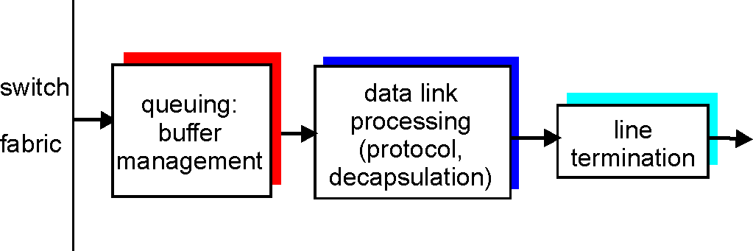
Look Inside a Router: Output Port
Buffering required when datagrams arrive from fabric faster than the transmission rate
Queueing (delay) and loss due to output port buffer overflow !
Scheduling and queue/buffer management choose among queued datagrams for transmission

Slide 27
Putting it Together: Example 2 (Different Networks): A-> E
forwarding table in router
misc
fields
223.1.1.1
223.1.2.3
data
Dest. Net router Nhops interface
Setting: Packet above arrives at Router C’s network layer.
Action:
Router C conducts standard router actions
Assume packet correct, find next hop should be 223.1.2.9
Hand datagram to link layer to send inside a link-layer frame
223.1.1/24 - 1 223.1.1.4
223.1.2/24 - 1 223.1.2.9
223.1.3/24 - 1 223.1.3.27
0.0.0.0/0 - - 223.1.4.1
A
To Internet
223.1.1.1
223.1.4.1
223.1.2.1
223.1.1.2
223.1.1.4
223.1.2.9
frame dst, src addr
datagram source,
dest address
B
C
223.1.2.3
223.1.1.3
223.1.3.27
E
E’s MAC
addr
C’s MAC
addr
A’s IP
addr
E’s IP
addr
IP payload
223.1.3.1
223.1.3.2
datagram
frame
datagram arrives at 223.1.2.3!! (hooray!)

Slide 28

Summary of Network Layer
We have covered the very basics of the network layer
routing and basic forwarding
There are multiple other topics that we did not cover
Multicast/anycast
QoS
slides as backup just in case you need reading in the winter

Slide 29
Roadmap: The Hourglass Architecture of the Internet
Telnet
Email
FTP
WWW
TCP
UDP
IP
Ethernet
Wireless
FDDI
ADSL
CableDOCSIS

Slide 30
Outline
Admin and recap
Network layer
Link layer

Slide 31
Link Layer Services
Framing
encapsulate datagram into frame, adding header, trailer and error detection/correction
Multiplexing/demultiplexing
frame headers to identify src, dest
Reliable delivery between adjacent nodes
we learned how to do this already !
seldom used on low bit error link (fiber, some twisted pair)
common for wireless links: high error rates
Media access control
Forwarding/switching with a link-layer (Layer 2) domain

Slide 32
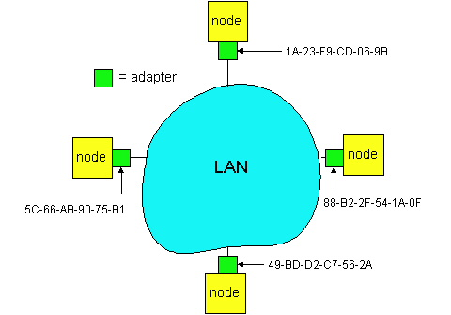
Adaptors Communicating
datagram
link layer protocol
receiving
node
sending
node
frame
frame
adapter
adapter
link layer typically implemented in “adaptor” (aka NIC)
Ethernet card, modem, 802.11 card, cloud virtual switch
adapter is semi-autonomous, implementing link & physical layers
in most link-layer, each adapter has a unique link layer address (also called MAC address)

Slide 33
Outline
Admin and recap
Network layer
Link layer
Overview
Media access
Link layer forwarding

Slide 34
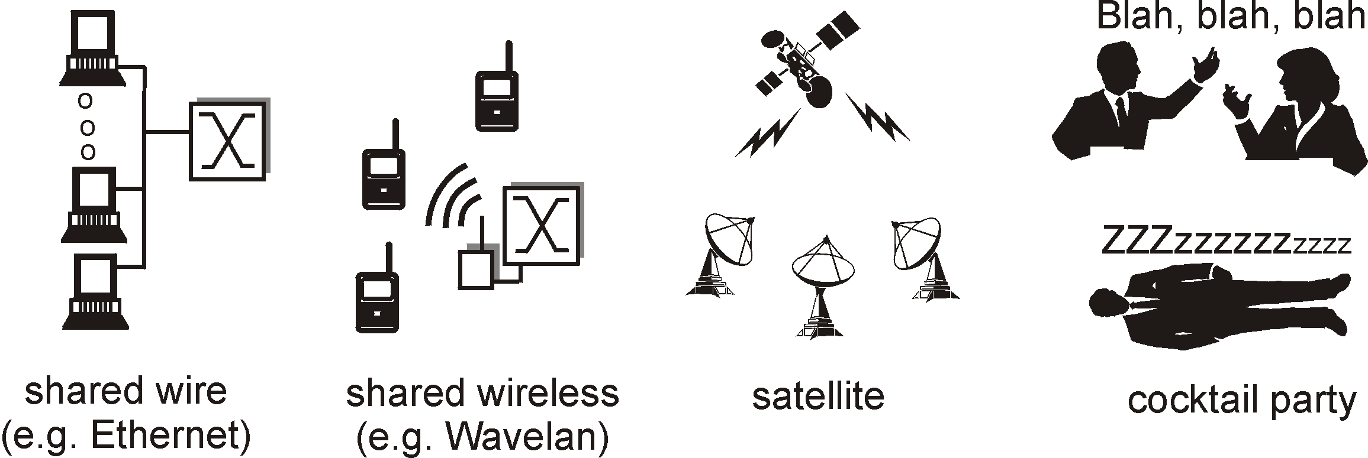
Multiple Access Links and Protocols
Many link layers use broadcast (shared wire or medium)
traditional Ethernet; Cable networks
802.11 wireless LAN; cellular networks
satellite
Problem: if two or more simultaneous transmissions, due to interference, only one node can send successfully at a time (see CDMA later for an exception)

Slide 35
Multiple Access Protocol
Protocol that determines how nodes share channel, i.e., determines when nodes can transmit
Communication about channel sharing must use channel itself !
Discussion: properties of an ideal multiple access protocol.

Slide 36
Ideal Mulitple Access Protocol
Broadcast channel of rate R bps
Efficiency: when only one node wants to transmit, it can send at full rate R
Rate allocation:
simple fairness: when N nodes want to transmit, each can send at average rate R/N
we may need more complex rate control
Decentralized:
no special node to coordinate transmissions
no synchronization of clocks
Simple

Slide 37
MAC Protocols
Goals
efficient, fair, decentralized, simple
Three broad classes:
non-partitioning
random access
allow collisions
“taking-turns”
a token coordinates shared access to avoid collisions
channel partitioning
divide channel into smaller “pieces” (time slot, frequency, code)

Slide 38
Focus: Random Access Protocols
Examples of random access MAC protocols:
slotted ALOHA and pure ALOHA
CSMA and CSMA/CD, CSMA/CA
Ethernet, WiFi 802.11
Key design points:
when to access channel?
how to detect collisions?
how to recover from collisions?

Slide 39

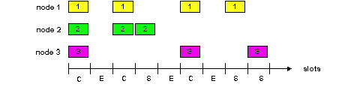
Slotted Aloha [Norm Abramson]
Time is divided into equal size slots (= pkt trans. time)
Node with new arriving pkt: transmit at beginning of next slot
If collision: retransmit pkt in future slots with probability p, until successful.
Success (S), Collision (C), Empty (E) slots

Slide 40
Slotted Aloha in Real Life
call setup in GSM
MS
BTS
Notations:
Broadcast control channel (BCCH): from base station, announces cell identifier, synchronization
Random access channel (RACH): MSs for initial access, slotted Aloha
access grant channel (AGCH): BTS informs an MS its allocation
standalone dedicated control channel (SDCCH): signaling and short message between MS and an MS
Traffic channels (TCH)
RACH (request signaling channel)
AGCH (assign signaling channel)
SDCCH (request call setup)
SDCCH message exchange
SDCCH (assign TCH)
Communication

Slide 41
Slotted Aloha Efficiency
Q: What is the fraction of successful slots?
suppose n stations have packets to send
suppose each transmits in a slot with probability p
- prob. of succ. by a specific node: p (1-p)^{(n-1)}
- prob. of succ. by any one of the N nodes
S(p) = n * Prob (only one transmits)
= n p (1-p)^{(n-1)}

